Slide 1

IMPLEMENTING innovative intersections USING ICE
August 15, 2019
Arkansas TRC Transportation Conference & Equipment Expo
Mark Doctor
FHWA Resource Center
Atlanta, GA

Slide 2
Intersection Fatalities -2017
137
14
50
29
44
76
25
134
14
198
409
15
20
335
104
1043
122
298
15
64
68
97
393
276
371
83
200
47
228
111
201
199
43
211
180
292
100
294
156
207
10
888
71
234
120
181
450
167
19
1225
33
Note: Focus States are those where ratio of Actual/Expected intersection fatalities exceed 1.0 relative to Rural/Urban adjusted Centerline Miles, Vehicle Miles Traveled and Population (rev 2014)
Top 10 Intersection Fatalities
FHWA Intersection
Focus States
Top 10 and
Int Focus State
Data source: FARS (2017)
Notes:
FARS 2017
id State Total
1 Alabama 181
2 Alaska 19
4 Arizona 292
5 Arkansas 71
6 California 1043
8 Colorado 200
9 Connecticut 83
10 Delaware 43
11 District of Columbia 10
12 Florida 1225
13 Georgia 450
15 Hawaii 33
16 Idaho 50
17 Illinois 393
18 Indiana 276
19 Iowa 97
20 Kansas 111
21 Kentucky 211
22 Louisiana 167
23 Maine 44
24 Maryland 180
25 Massachusetts 104
26 Michigan 335
27 Minnesota 134
28 Mississippi 120
29 Missouri 201
30 Montana 29
31 Nebraska 68
32 Nevada 122
33 New Hampshire 14
34 New Jersey 228
35 New Mexico 100
36 New York 409
37 North Carolina 294
38 North Dakota 25
39 Ohio 371
40 Oklahoma 156
41 Oregon 76
42 Pennsylvania 298
44 Rhode Island 15
45 South Carolina 234
46 South Dakota 20
47 Tennessee 207
48 Texas 888
49 Utah 64
50 Vermont 14
51 Virginia 199
53 Washington 137
54 West Virginia 47
55 Wisconsin 198
56 Wyoming 15

Slide 3
Arkansas Strategic Highway Safety Plan
Key Statistics
Arkansas Intersection Fatalities:
About half urban / half rural
90% at un-signalized intersections

Slide 4
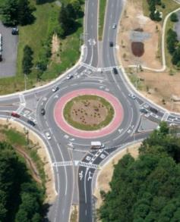
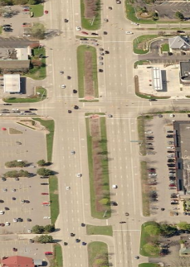
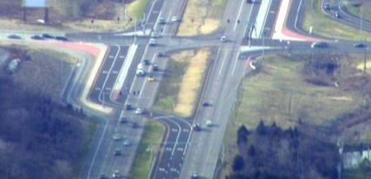
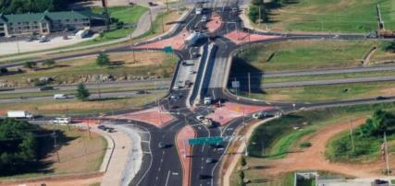
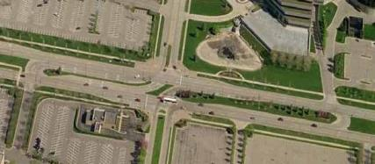
EDC-2
Intersection & Interchange Geometrics
(2013-14)
Roundabouts
Median U-Turns
These solutions reduce severe crashes while enhancing efficiency
Displaced Left-Turn (DLT)
Source: FHWA
Source: FHWA-RD-09-060
Diverging Diamond Interchange (DDI)
Restricted-Crossing U-Turn (RCUT)

Slide 5


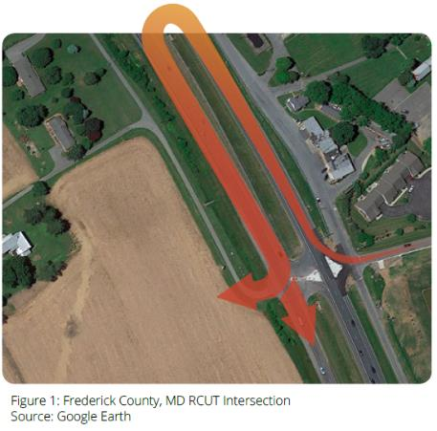
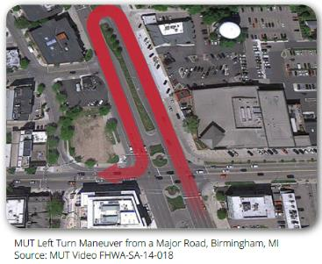
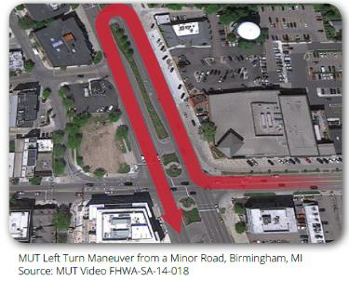
Reduced Left-Turn Conflict Intersections
U-Turn Based Left-Turn Movements
(or “Redirected Left-Turn Movements”)
Restricted Crossing U-Turn (RCUT)
Median U-Turn (MUT)

Slide 6
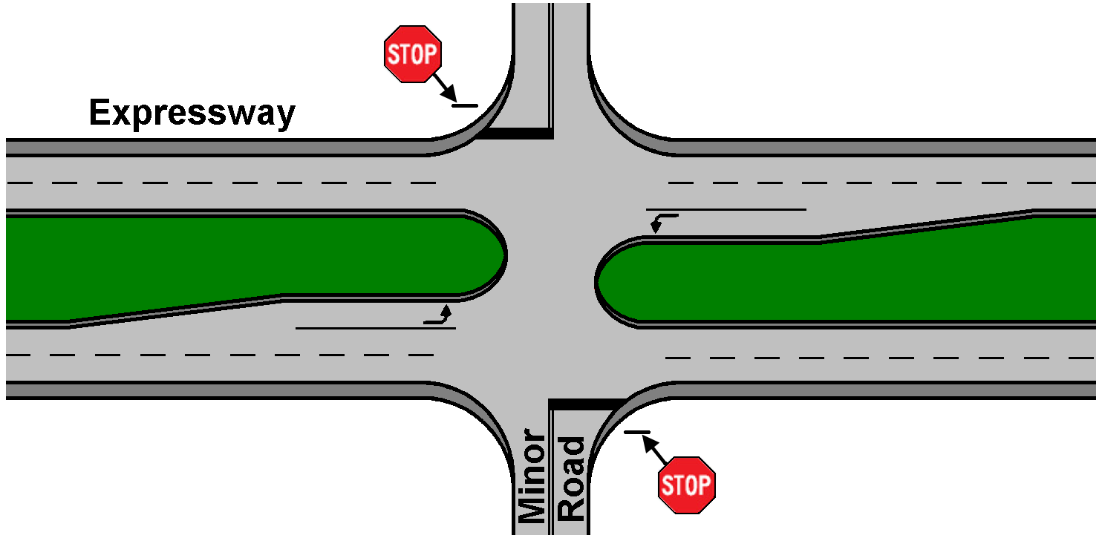
Divided Highway: Open Median Intersection
Common Problem: Far-Side Right-Angle Collisions
Major Road

Slide 7
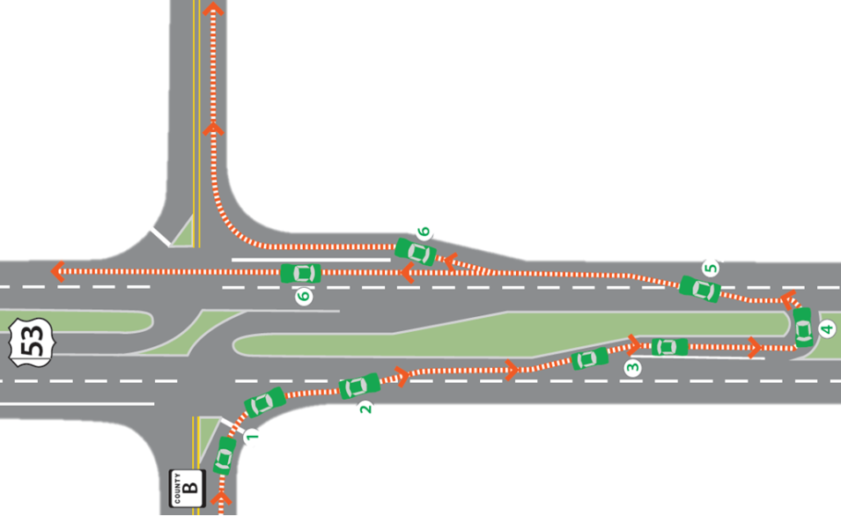
RCUT / J-Turn / Superstreet
Minor Road traffic turns right, then utilizes U-turn to proceed in desired direction.
Main and U-turn intersections can be either signalized (“Superstreet”) or not (“J-Turn”)
Source: Wisconsin DOT
Notes:
The first of these is the RCUT, which is typically implemented along multilane divided highways, which are often high speed, high volume facilities.
With the RCUT, all movements from the mainline are allowed. However, the left-turn and through movements from the minor road approaches are removed from the intersection and accommodated by median openings along the mainline.
To understand why this treatment makes sense, consider the degree of difficulty in being the minor road vehicle attempting to cross or turn left onto the divided highway. Finding a gap across multiple directions and lanes, where vehicles are moving at very high speeds can be intimidating and time consuming. As an alternative, the RCUT design asks a driver to make a series of less complex decisions, taking advantage of more frequent gaps, and making movements that are associated with less severe conflict types.
This treatment can be implemented where the main intersection is either signalized or stop controlled, and the median openings can operate as signalized or unsignalized access points depending on traffic volumes.

Slide 8
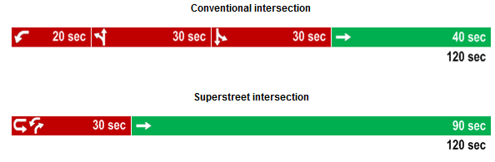
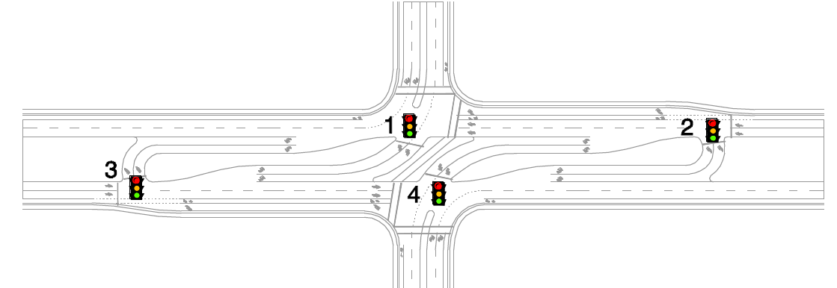
Better Signal Operations
Signalized RCUTs operate with 2-phases allowing more green time to the major street through
Better signal progression
Shorter cycle lengths than comparable conventional intersections may be possible
  Shorter cycles reduce delay for most vehicles and for pedestrians
RCUTs can even offer an ability to have different cycle lengths in the two directions of the major street

Slide 9
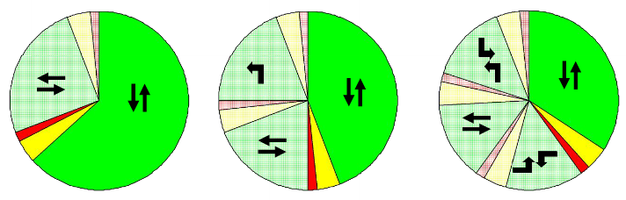
The “Secret Sauce”
Fewer phases (intervals) allows more green time for the major through movement and decreases intersection delays
- Fewer phases also means less “lost time”
BETTER

Slide 10
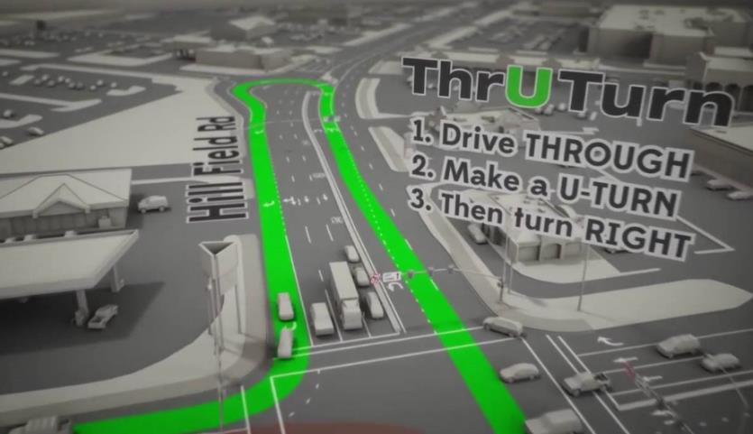
Median U-Turn / ThrU-Turn
Source: https://www.youtube.com/watch?v=a11wVxLIe6s

Slide 11
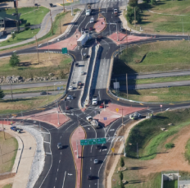
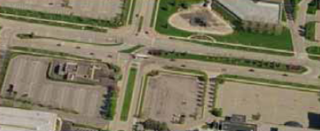
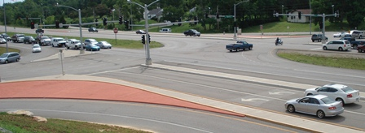
Innovative Intersection Solutions
Essential ingredients:
Improve the way people move across intersections
Eliminate, relocate or modify conflict points
Strategically optimize traffic control
“cho·re·og·ra·phy”
Source: Missouri Department of Transportation
Source FHWA
Source: Mark Doctor, FHWA

Slide 12
Innovative Intersection Benefits
SAFETY
MOBILITY
VALUE
  Fewer, less severe conflict points
  Significant crash reductions
  Speed management potential
  Shorter trip duration
  Better trip reliability
  Reduced congestion
  Opportunities for walking and biking
  Less right-of-way
  Quicker construction
  Decreased costs
  Balanced solutions
For greater benefits, emphasize Corridor or Network level approaches!

Slide 13
Long Term Vision for Advancing Innovative, Safer Intersections
Agencies include innovative intersection solutions in their evaluation processes or policies in a manner that ensures they are considered and evaluated alongside other improvement alternatives, and implemented when appropriate.
aka Intersection Control Evaluation (ICE)
Policies/Procedures

Slide 14
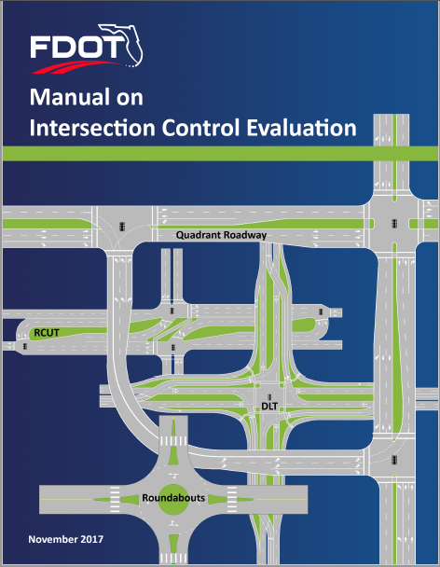
Intersection Control Evaluation
“The goal of ICE is to better inform the FDOT’s decision-making to identify and select a control strategy meeting the project’s purpose and need, fitting the intersection location’s context classification, providing safe travel facilities for all road users, and reflecting the overall best value.”
https://www.fdot.gov/traffic/TrafficServices/Intersection-Operations.shtm

Slide 15
State Progress on ICE Policies
(as of July 15, 2019)
July 2019
DC
PR
FLH
Existing
ICE Policies
Developing
ICE Policies
Interest in
ICE Policies

Slide 16
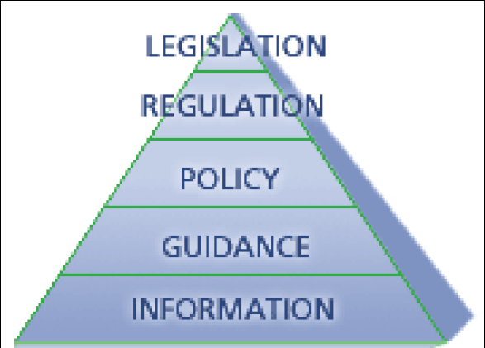
Generally, ICE is…
POLICY
Establishes the general applicability and sets forth a course of action, plan or procedure with an expectation that it will be implemented and adhered to without deviation
PROCESS
Describes the framework and methodologies by which a Policy can be successfully implemented; describes the desired outcomes; facilitates consistency of effort and results

Slide 17
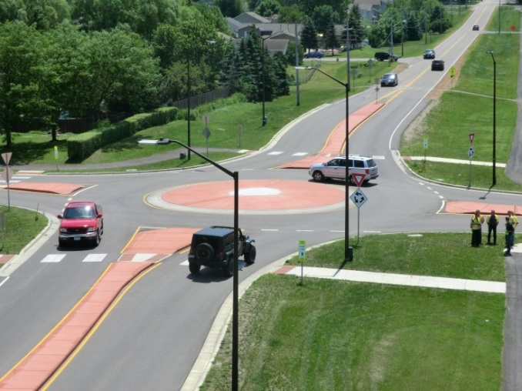
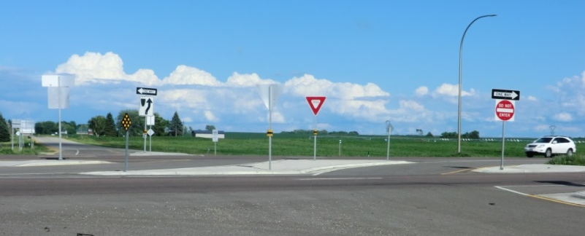
Why ICE?
Advance progress for deploying innovative intersections
  Routine, objective and consistent consideration
Complements performance-oriented program framework and value-based project delivery

Slide 18
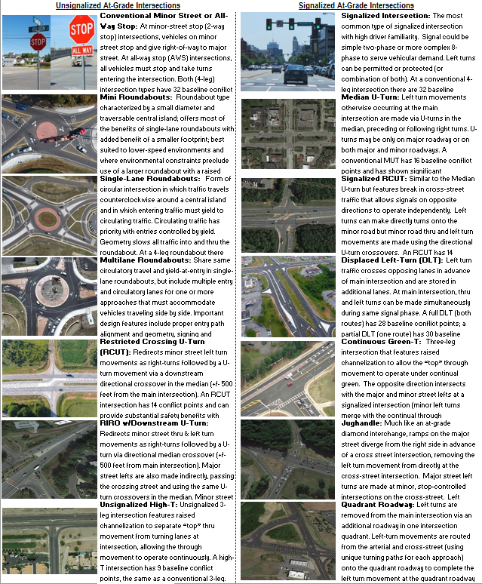
ICE promotes the consideration of the wide array of intersection forms and control options including variations on typical forms
Source: Georgia DOT ICE Tool

Slide 19
ICE Lead State Lessons Learned
ICE helped meet the following needs:
  Helped advance alternative intersections
  Incorporates safety performance in to scoping stage
  Helped vet possibilities for context and risk
  Addressed concerns about documentation sufficiency and consistency
  Provides a basis for early non-motorized assessment

Slide 20
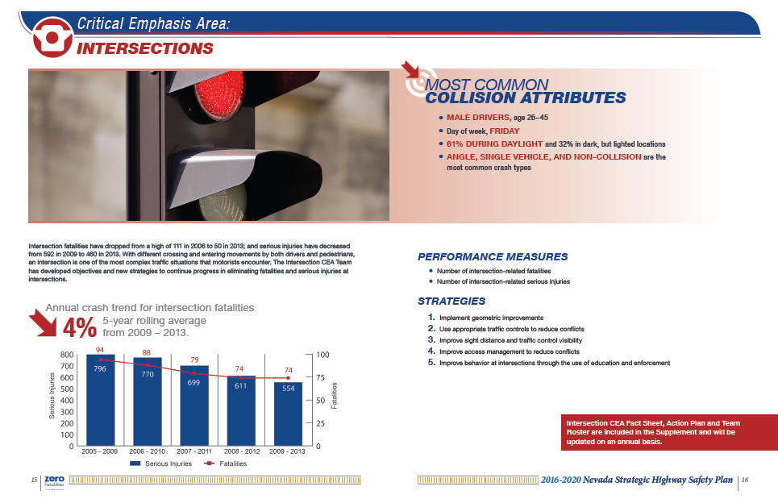
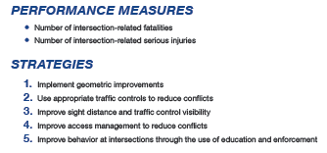
Realizing SHSP Vision
ICE is cross-cutting and can link SHSP priorities to all facets of highway program

Slide 21
ICE and Safety PM Final Rule
Safety PM Final Rule establishes 5 performance measures to carry out HSIP (5-year rolling avgs):
  (1) Number of Fatalities
  (2) Rate of Fatalities per 100 million VMT
  (3) Number of Serious Injuries
  (4) Rate of Serious Injuries per 100 million VMT
  (5) Number of Non-motorized Fatalities and Serious Injuries
States establish and report on targets; annual evaluation on meeting or making significant progress toward targets
ICE Policies/Procedures can help achieve
Safety PM targets across entire highway program
(Not limited to HSIP)!
Notes:
Safety PM Final Rule establishes five performance measures to carry out the HSIP: the five-year rolling averages for: (1) Number of Fatalities, (2) Rate of Fatalities per 100 million VMT, (3) Number of Serious Injuries, (4) Rate of Serious Injuries per 100 million VMT, and (5) Number of Non-motorized Fatalities and Non-motorized Serious Injuries.
These safety performance measures are applicable to all public roads regardless of ownership or functional classification. The Safety PM Final Rule also establishes a common national definition for serious injuries.
State Targets
States will establish statewide targets for each of the safety performance measures. States also have the option to establish any number of urbanized area targets and one non-urbanized area target for any or all of the measures. Targets will be established annually, beginning in August 2017 for calendar year 2018. For common performance measures (number of fatalities, rate of fatalities and number of serious injuries), targets must be identical to the targets established for the NHTSA Highway Safety Grants program. The State DOT must also coordinate with the MPOs in the State on establishment of targets, to the maximum extent practicable. States will report targets to the FHWA in the HSIP report due in August of each year.

Slide 22

The ICE Framework
Typically a 2-Stage Screening Process
Stage 1 – project scoping exercise, high-level performance-based assessment, considers all possibilities, quickly filters down to a short list
Stage 2 – preliminary engineering, more rigorous assessment of the performance criteria for short listed options
Goal: Consistent…Objective…Safer

Slide 23
ICE Performance Criteria
Safety (substantive, not nominal)
Operations (core MOEs, not LOS)
Right-of-Way Impacts
Costs
Practical Feasibility (i.e., local posture)
Pedestrians and Bicycles
Freight Network (incl. OSOW)
Environmental Impacts

Slide 24
Tools to Support ICE
National Resources
SPICE & CAP-X
    http://www.cmfclearinghouse.org/resources_selection.cfm
LCCET (via NCHRP 03-110)
    http://www.trb.org/Main/Blurbs/173928.aspx
State & Local Resources
Kentucky (IDAT)
Georgia (ICE Tool)
Virginia (V-JuST)
Florida ICE Tool
Pennsylvania ICE Tool
Pima Co (AZ) PISCES
View the recorded webinar via the FHWA Web Conferencing Portal:
https://collaboration.fhwa.dot.gov/dot/fhwa/WC/default.aspx

Slide 25

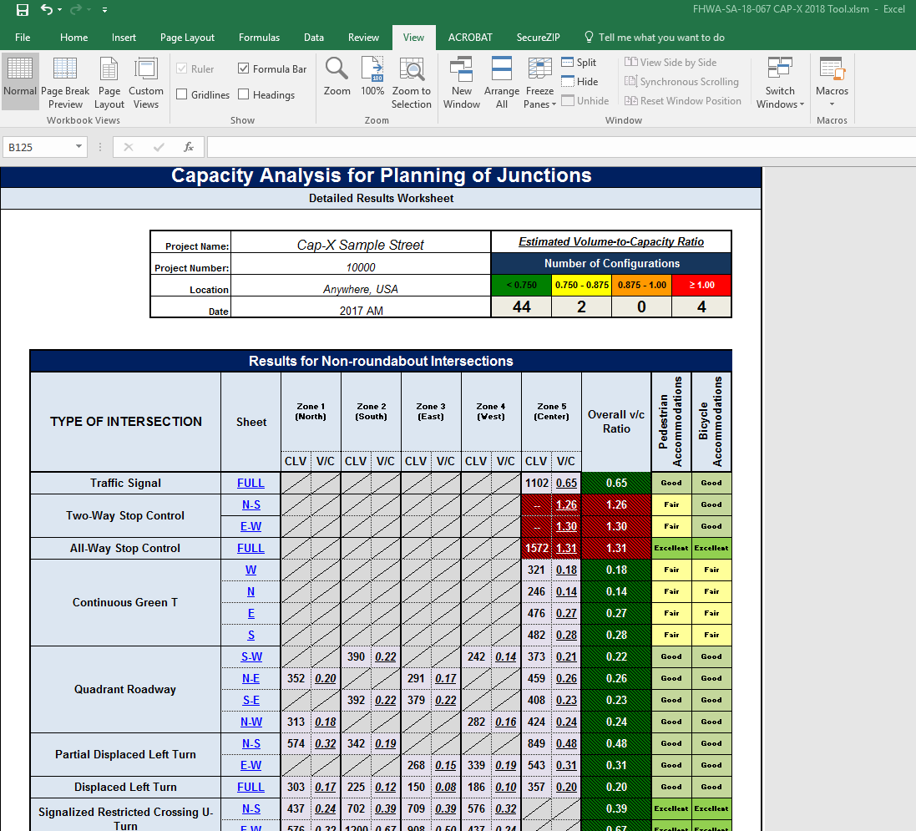

Slide 26

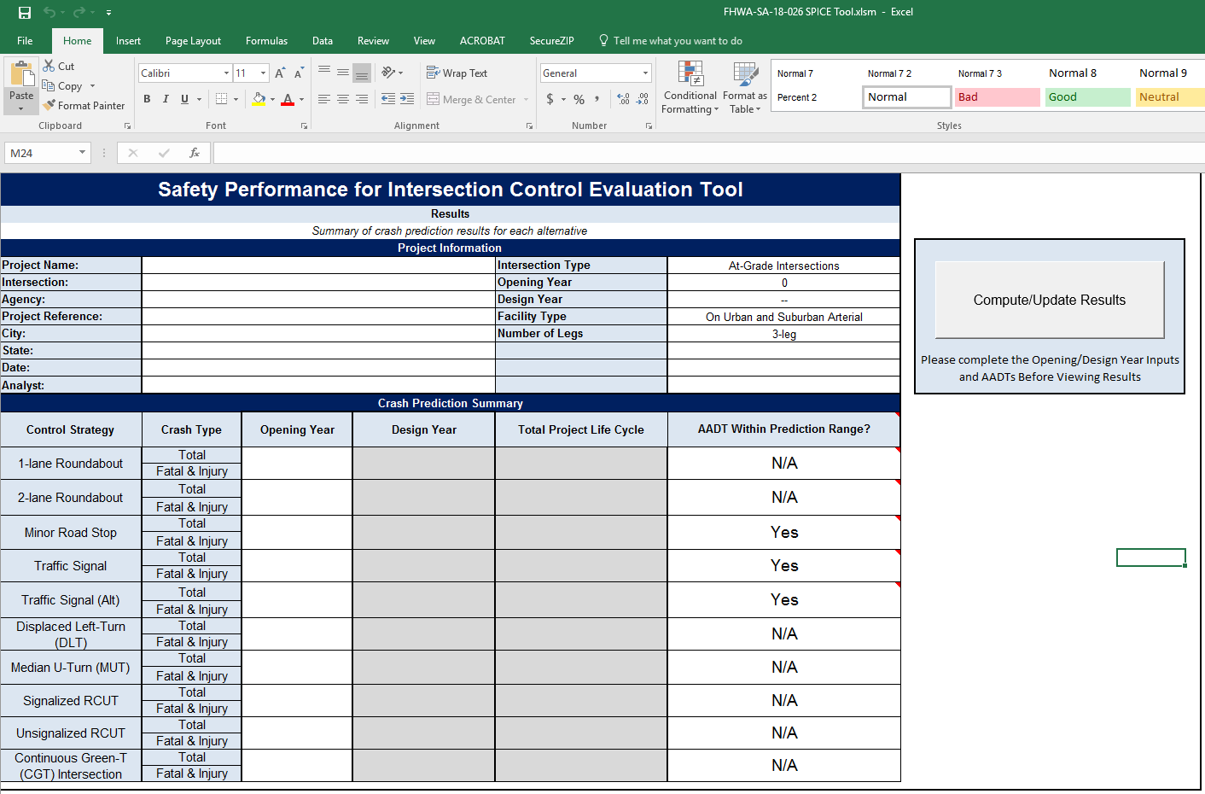

Slide 27


Arkansas Strategic Highway Safety Plan
“The SHSP is applicable to all organizations that play a part on addressing highway safety in Arkansas. The SHSP emphasis areas and strategies address the 4E’s (engineering, education, enforcement and emergency services) of highway safety.”

Slide 28

Achieving Holistic Solutions
“A Safe System requires understanding and managing the complex and dynamic interaction between operating speeds, vehicles, road infrastructure and road user behavior, in a holistic and integrated way, so that the sum of the individual parts of the system combine for a greater overall effect and if one part fails the other parts will still prevent serious harm from occurring.”
Zero Road Deaths and Serious Injuries: Leading a Paradigm Shift to a Safe System - October 2016
Excerpts from the Foreword
http://www.oecd.org/publications/zero-road-deaths-and-serious-injuries-9789282108055-en.htm

Slide 29
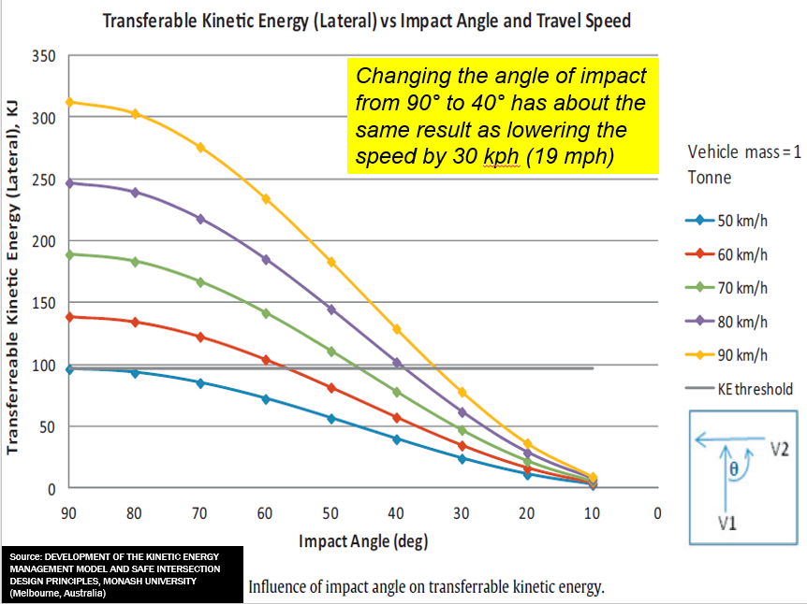
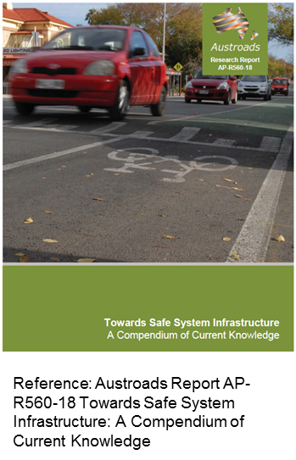
Toward a Safe Systems Approach
“Safe System is the management and design of the road system such that impact energy on the human body is firstly avoided or secondly managed at tolerable levels by manipulating speed, mass and crash angles to reduce crash injury severity.”
Notes:
Four Guiding Principles:
People make mistakes that lead to road crashes
The human body has a physical tolerance to crash forces before harm occurs
Shared responsibilities among users and those who design, build and maintain vehicles and roads
Strengthen all parts of the system so users are protected if one part fails

Slide 30
Converging on Success
Safe Systems for Intersections
Advancing Innovative Intersections
ICE Policies, Procedures and Tools
Proven Safety Countermeasures Toolbox
Programmatic Influences
(Performance-Based, Safety PM, Strategic Highway Safety Plans, etc.)

Slide 31
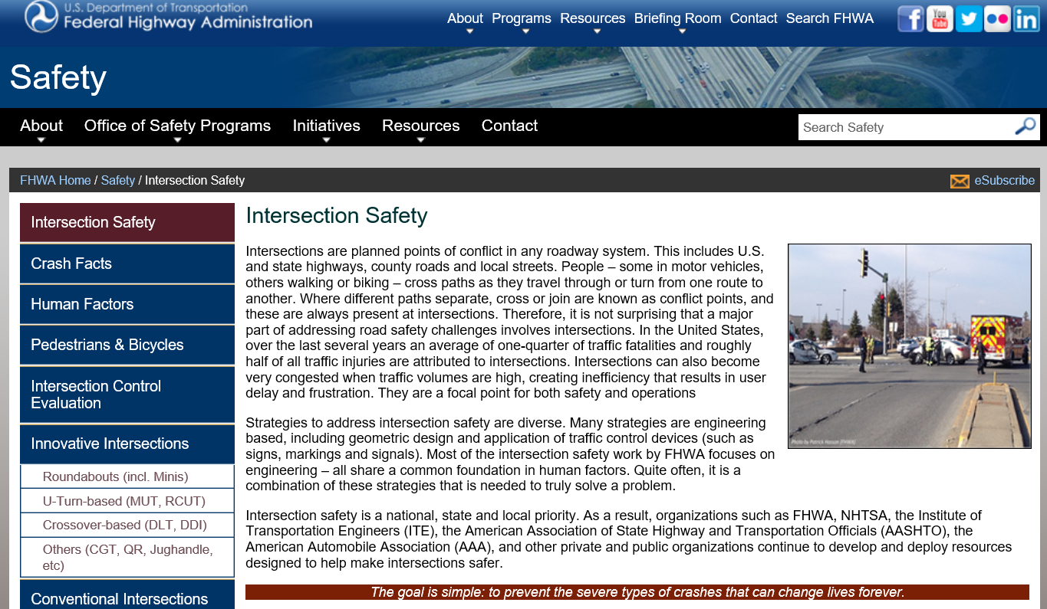

Thank You!
Contact Information:
Mark Doctor, P.E.
FHWA Resource Center
mark.doctor@dot.gov
(404) 562-3732
Jeffrey Shaw, P.E.
FHWA Office of Safety
jeffrey.shaw@dot.gov
(202) 738-7793
https://safety.fhwa.dot.gov/intersection/

